Slide 1
PG&E Predictions: Power for the People
Elliot Tam

Slide 2
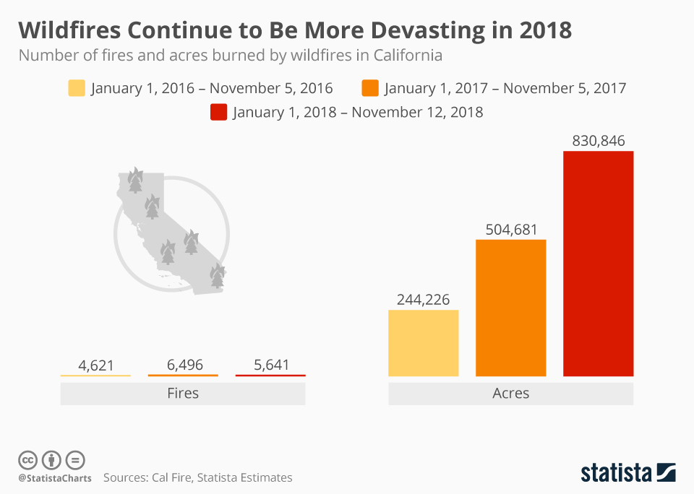
Wildfires
Notes:
DROUGHT > WILDFIRES > KINCADE FIRE – theorized started by PG&E power line
/MASKS > MAYOR AND PG&E

Slide 3
Public Safety Power Shutoff

Slide 4
Public Safety Power Shutoff
Low Humidity
High Winds
High Temperatures
Condition of dry fuel & vegetation
Notes:
Source: https://www.pge.com/en_US/safety/emergency-preparedness/natural-disaster/wildfires/public-safety-power-shutoff-faq.page

Slide 5
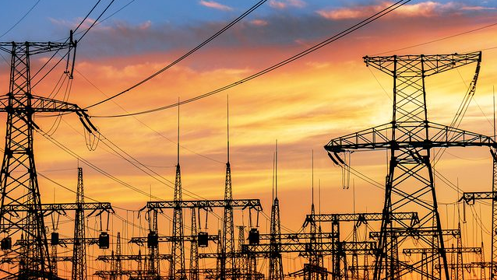
Electricity

Slide 6



Methodology
Data Collection

Slide 7


Methodology
Data Collection
Data Cleaning

Slide 8


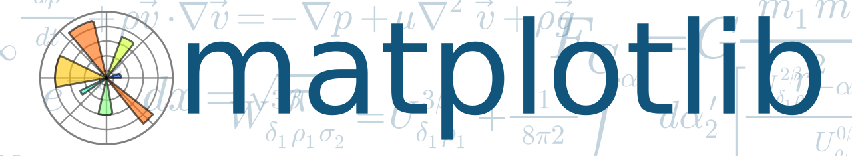
Methodology
Data Collection
Data Cleaning
Modeling & Visualization

Slide 9
Features
High Temperature
Humidity
Dewpoint
Wind Gust
Cover
Pressure

Slide 10
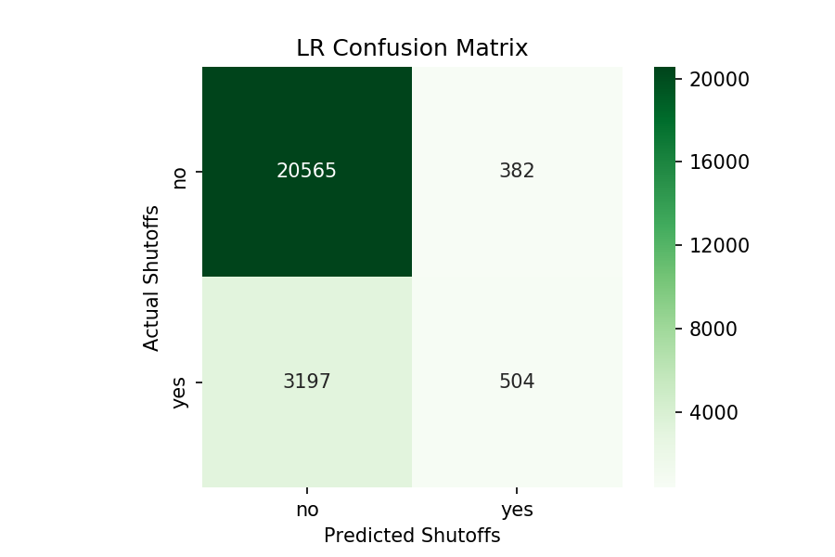
Model Results and Metrics
Notes:
Precision: 0.9713, Recall: 0.9597

Slide 11
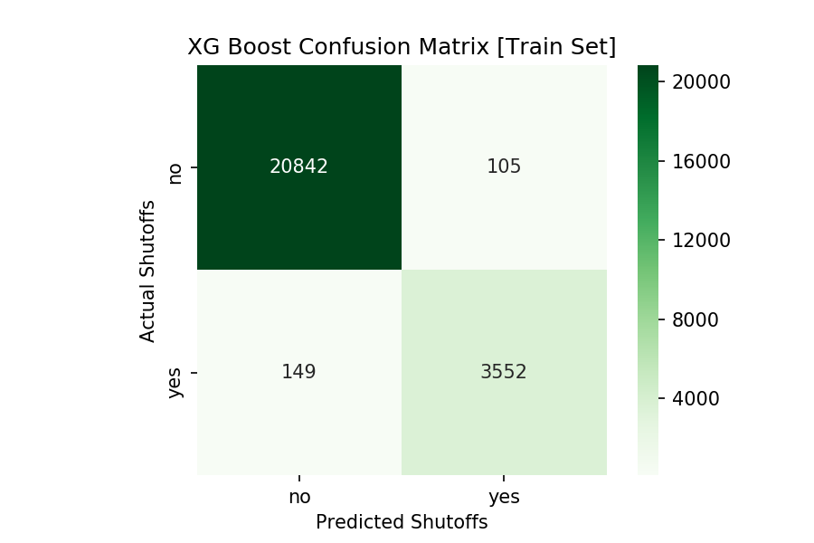
Model Results and Metrics
Precision: 0.9713, Recall: 0.9597
Notes:
Precision: 0.9713, Recall: 0.9597

Slide 12
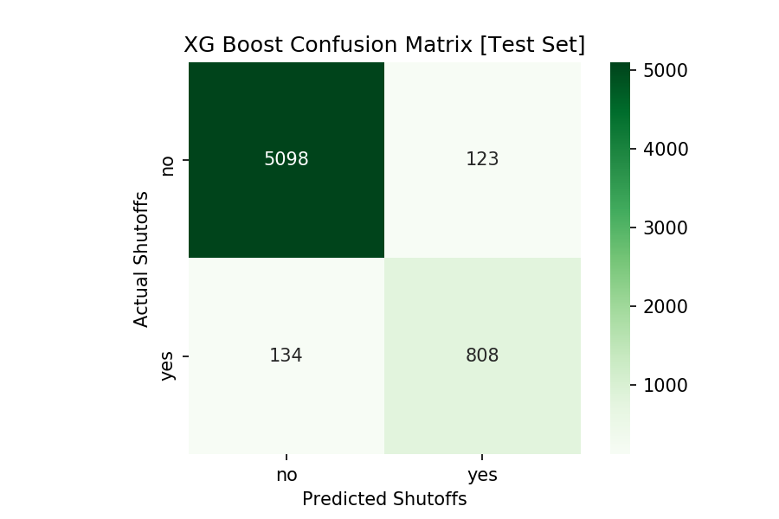
Model Results and Metrics
Precision: 0.8679, Recall: 0.8577

Slide 13
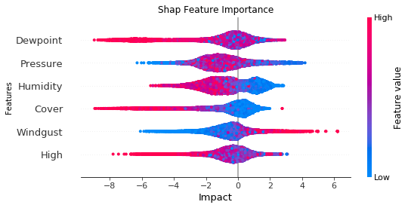
Model Results and Metrics

Slide 14
Applications

Slide 15

Applications

Slide 16

Applications

Slide 17

Applications

Slide 18
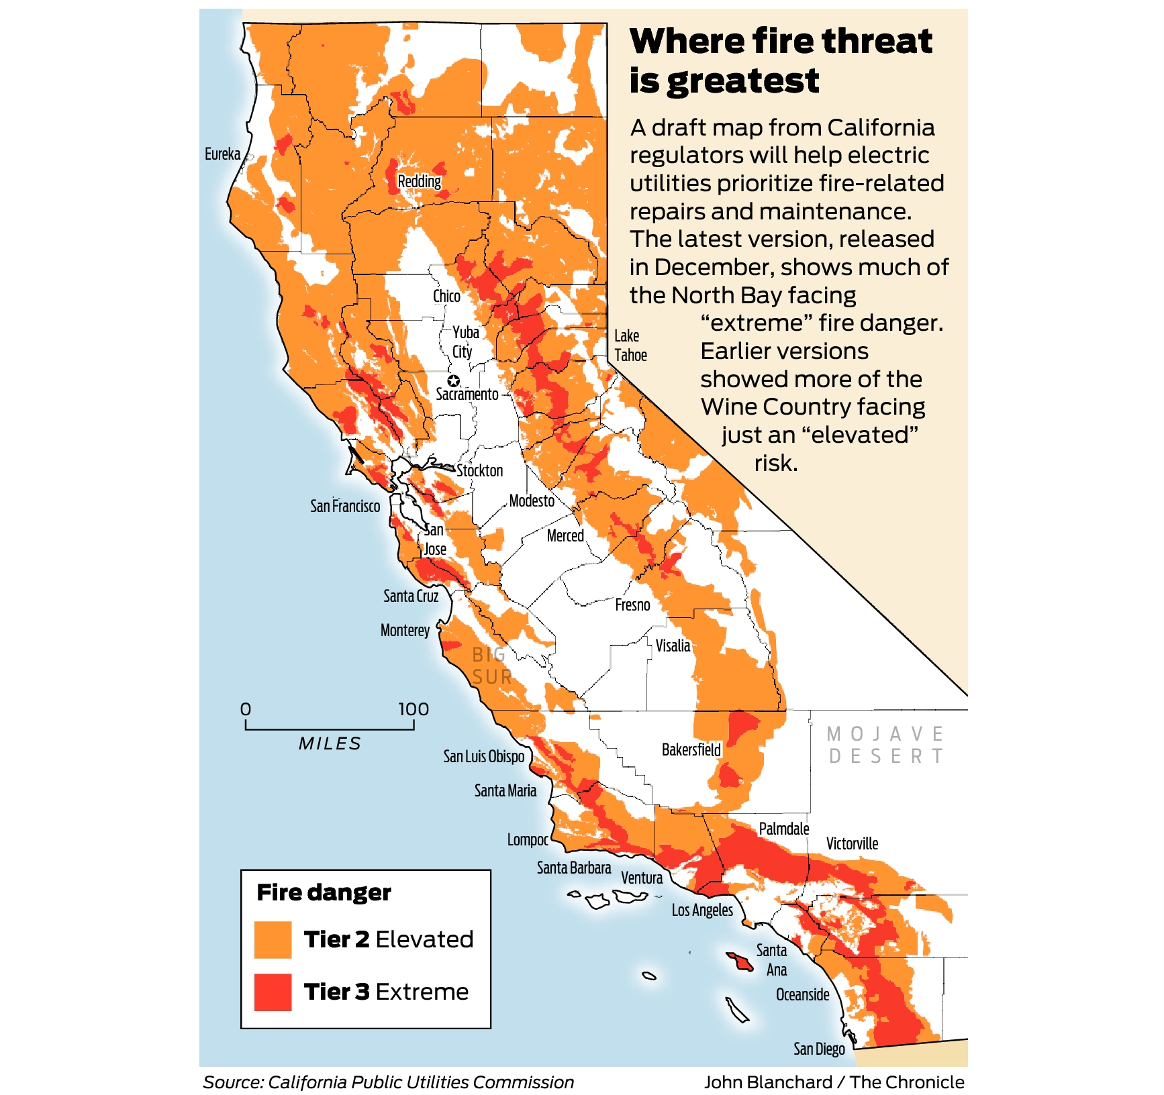
Future Work
Notes:
CPUC high fire threat areas
Time series features: dry fuel, start day

Slide 19
Thank You!

Slide 20
Appendix

Slide 21
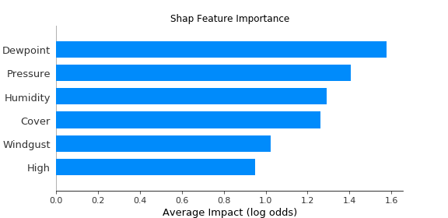
Appendix: Feature Importance

Slide 22
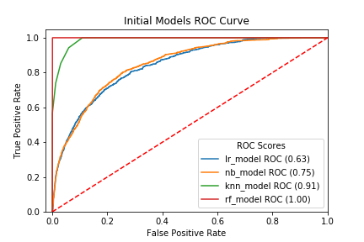
Appendix: Initial Models

Slide 23
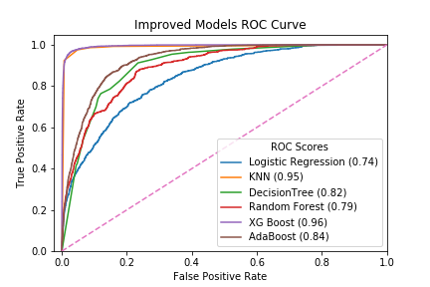
Appendix: Improved Models

Slide 24
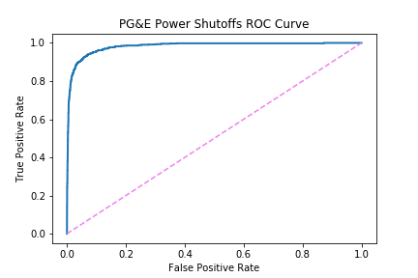
Appendix: Model ROC

Slide 25
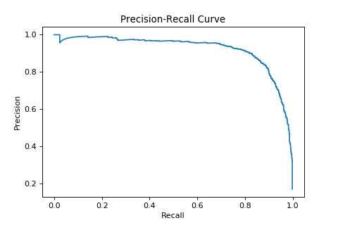
Appendix: Precision - Recall

Slide 26
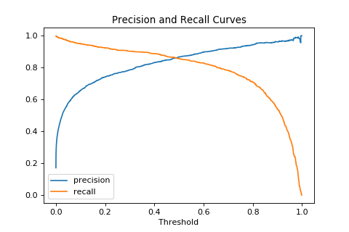
Appendix: Threshold

Slide 27
Appendix: Features
High Temperature
Low Temperature
Humidity
Dewpoint
Wind Speed
Wind Gust
Cover

Slide 28
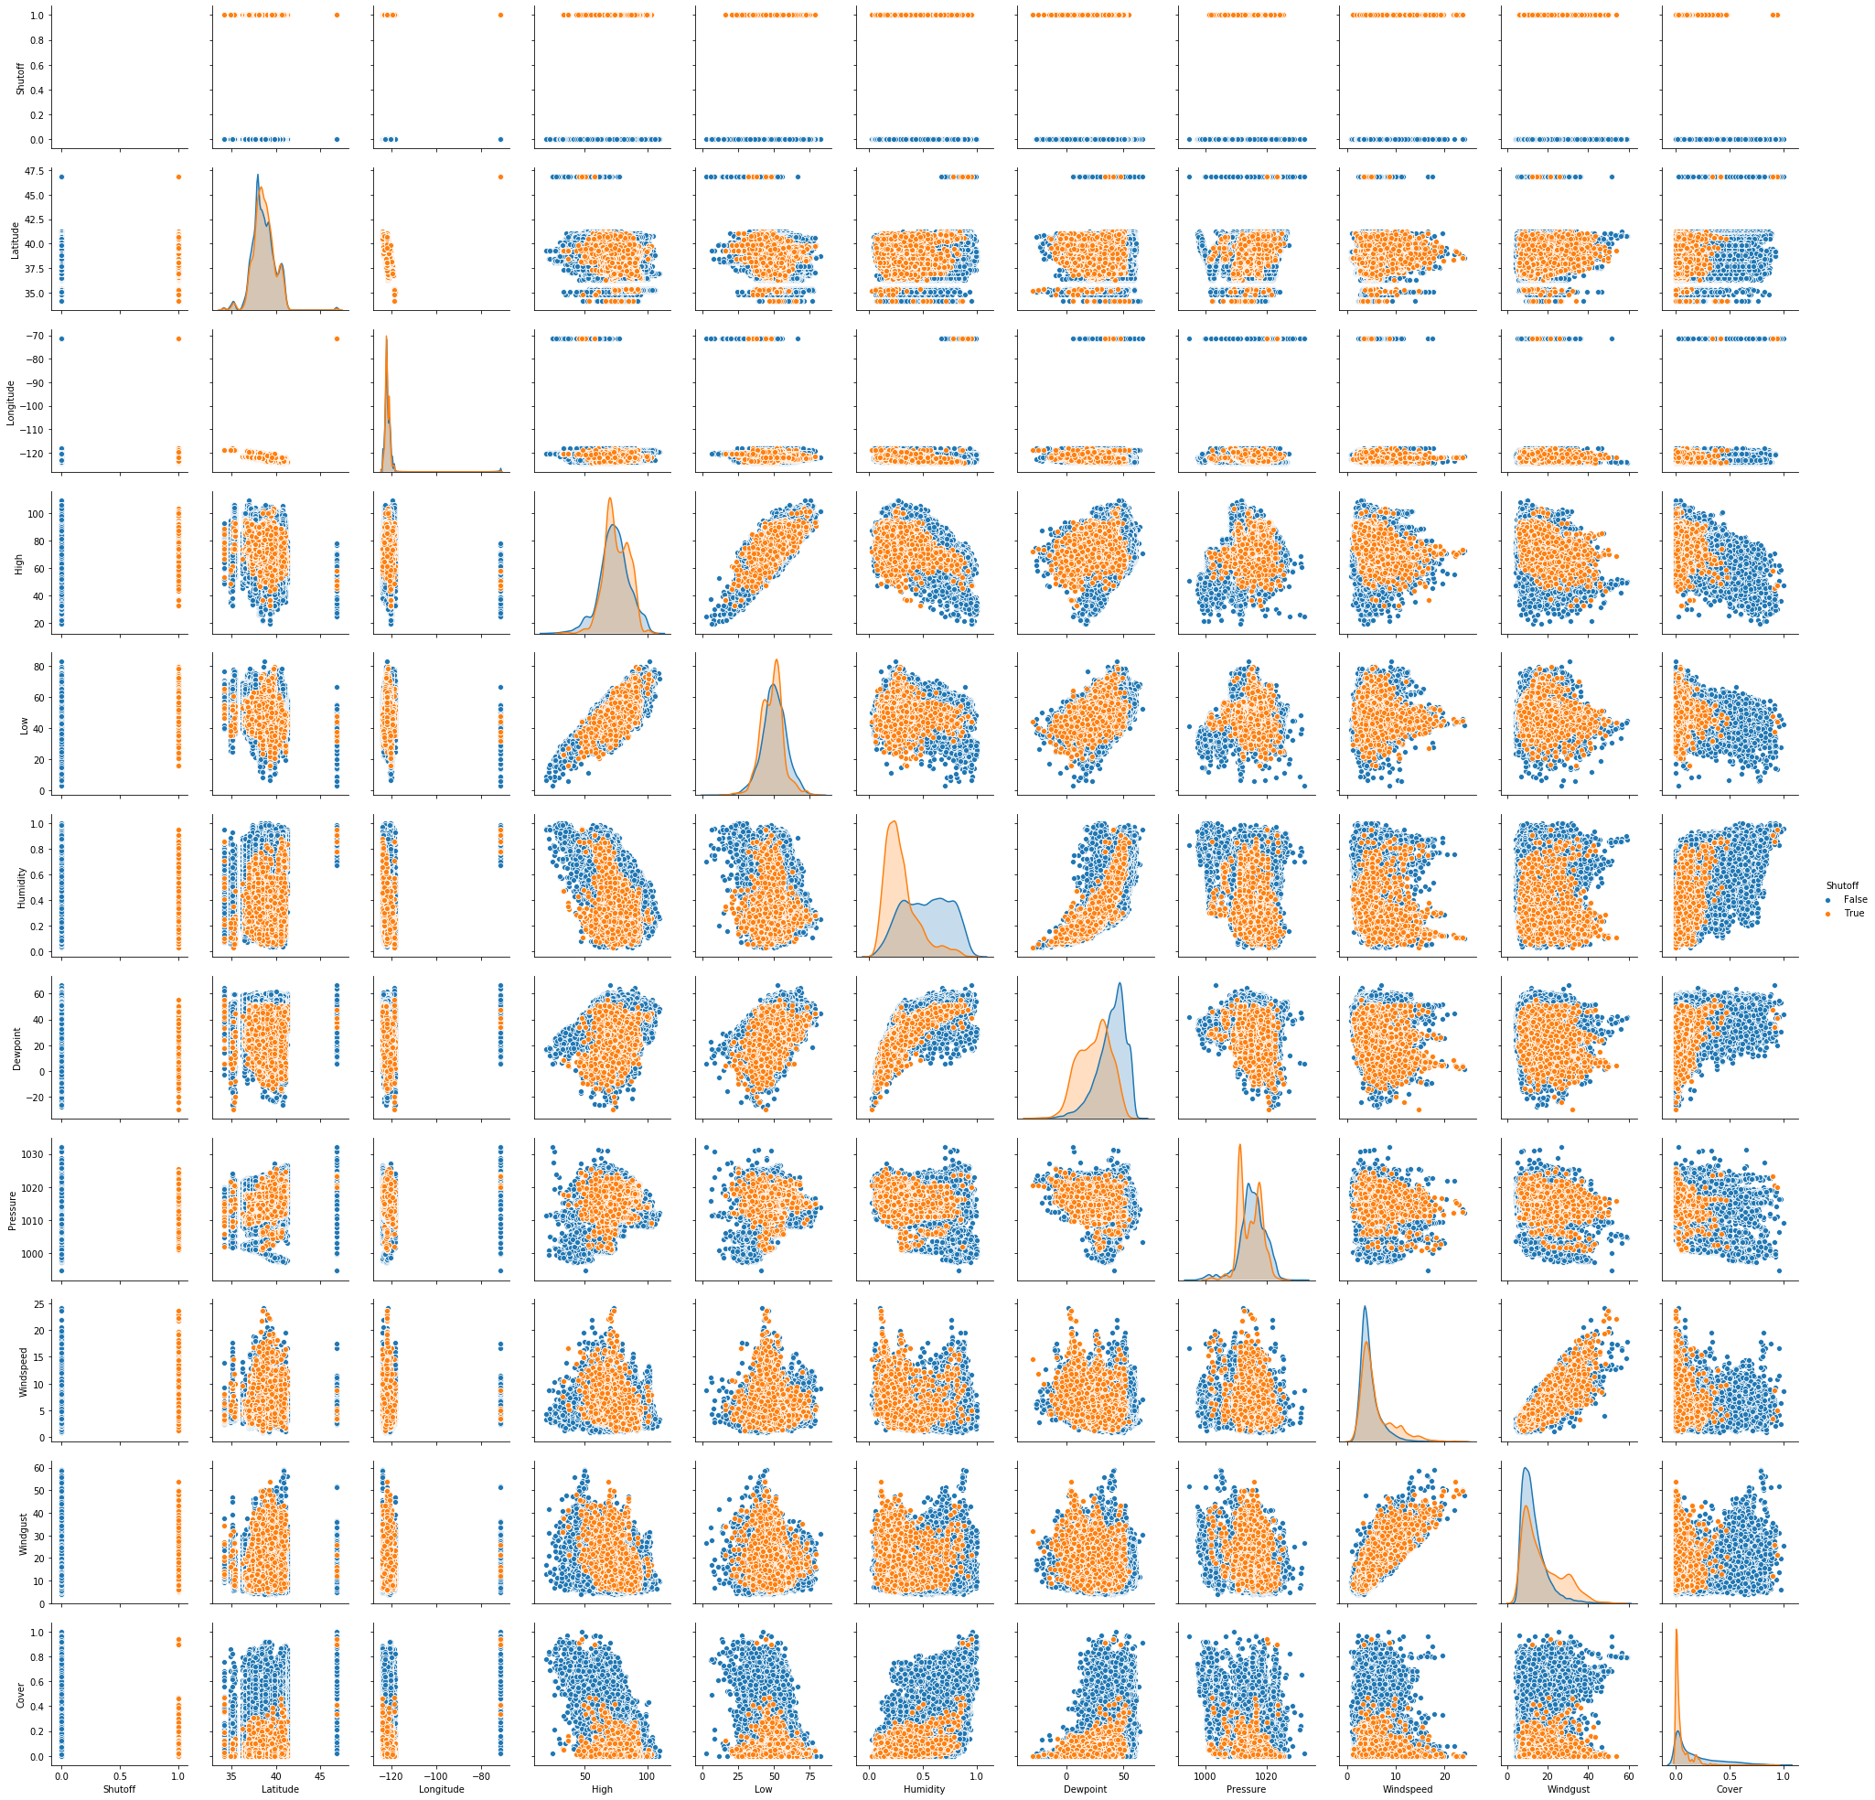
Appendix: Pairplot

